Slide 1

Modeling of Attempt-to-Escape Frequency under Detrap Retention of Bandgap-Enginnered 3D NAND Flash Memory Cell
진명
1/8
School of Electrical Engineering, Seoul National University

Slide 2
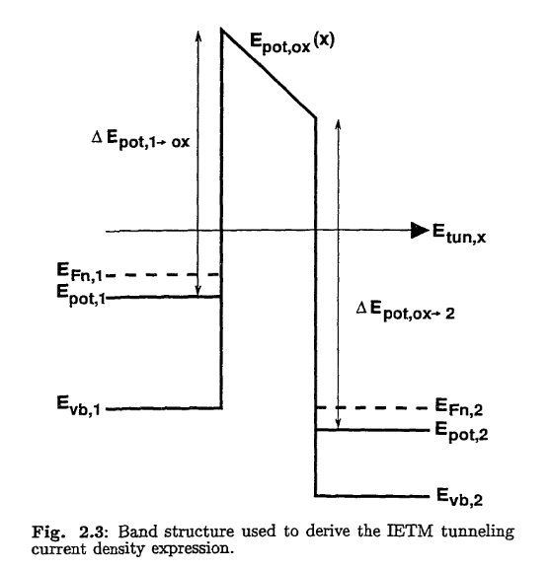

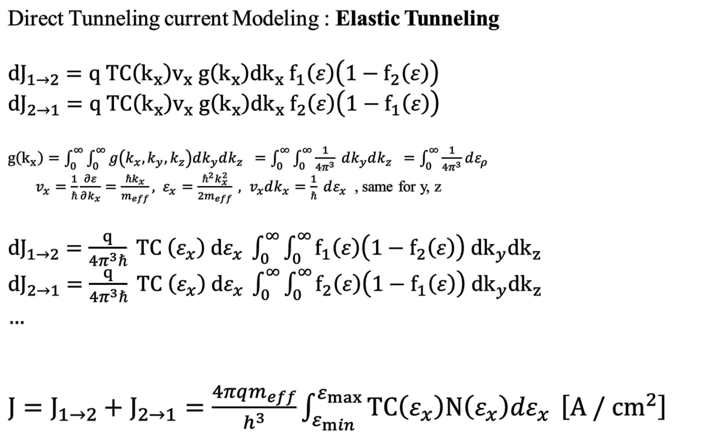
Attempt-to-Escape Frequency : Elastic Tunneling
Direct Tunneling current Modeling : Elastic Tunneling
${dJ}_{1→2}=q TC\left(k_{x}\right)v_{x} g\left(k_{x}\right){dk}_{x} f_{1}\left(ε\right)\left(1−f_{2}\left(ε\right)\right)$
${dJ}_{2→1}=q TC\left(k_{x}\right)v_{x} g\left(k_{x}\right){dk}_{x} f_{2}\left(ε\right)\left(1−f_{1}\left(ε\right)\right)$
$g\left(k_{x}\right)=\int_{0}^{∞}{\int_{0}^{∞}{g\left(k_{x}, k_{y}, k_{z}\right)dk_{y}dk_{z} } }=\int_{0}^{∞}{\int_{0}^{∞}{\frac{1}{4π^{3}} dk_{y}dk_{z} } }=\int_{0}^{∞}{\frac{1}{4π^{3}}dε_{ρ}}$
$v_{x}=\frac{1}{ℏ}\frac{∂ε}{∂k_{x}}=\frac{ℏk_{x}}{m_{eff}}, ε_{x}=\frac{ℏ^{2}k_{x}^{2}}{2m_{eff}} , v_{x}dk_{x}=\frac{1}{ℏ} dε_{x}$ , same for y, z
${dJ}_{1→2}=\frac{q}{4π^{3}ℏ} TC \left(ε_{x}\right) dε_{x} \int_{0}^{∞}{\int_{0}^{∞}{f_{1}\left(ε\right)\left(1−f_{2}\left(ε\right)\right) {dk}_{y}{dk}_{z}}}$
${dJ}_{2→1}=\frac{q}{4π^{3}ℏ} TC \left(ε_{x}\right) dε_{x} \int_{0}^{∞}{\int_{0}^{∞}{f_{2}\left(ε\right)\left(1−f_{1}\left(ε\right)\right) {dk}_{y}{dk}_{z}}}$
…
$J=J_{1→2}+J_{2→1}=\frac{4πqm_{eff}}{h^{3}}\int_{ε_{min}}^{ε_{max}}{TC\left(ε_{x}\right)N\left(ε_{x}\right)dε_{x}} \left[A / {cm}^{2}\right]$
Shiely, James Patrick. Simulation of tunneling in MOS devices. Duke University, 1999.
2/8
School of Electrical Engineering, Seoul National University

Slide 3


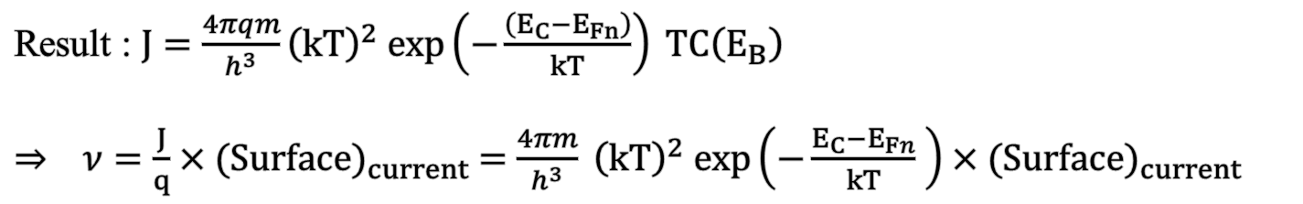



Attempt-to-Escape Frequency : Elastic Tunneling
No electron region
* Crucial Assumption
Electron in conduction band exists only within δE.
Quasi-Fermi level is formed at the tunneling barrier
$$E_{B}$$
$$δε$$
$$ε$$
TC(E_{B})
$E_{Fn}$
$E_{Fn} ≈E_{T}$
Result : $J=\frac{4πqm}{h^{3}}{\left(kT\right)}^{2} exp\left(−\frac{\left(E_{C}−E_{Fn}\right)}{kT}\right) TC\left(E_{B}\right)$
$⇒ ν=\frac{J}{q}×{(Surface)}_{current} =\frac{4πm}{h^{3}} {\left(kT\right)}^{2} exp\left(−\frac{E_{C}−E_{Fn}}{kT} \right)×{(Surface)}_{current}$
ν can be changed by the device scale
3/8
School of Electrical Engineering, Seoul National University

Slide 4
Elastic Tunneling Modeling
Assumption : $E_{Fn} ≈E_{T}$ $(∵Fermi level defines as electron stack up level in 0K equlibrium state)$
(Surface)_{Current} : TOX1 – BENitride interface region area
Retention Current
TOX2
TOX1
BENitride
Filler + channel
TOX1-BENitride interface
TOX1-BENitride interface
Direct Tunneling
$ν_{DT}=\frac{4πm}{h^{3}} {\left(kT\right)}^{2} exp\left(−\frac{E_{c}−E_{T}}{kT} \right)×\left(2πr_{tox}\right)l_{spacer} ≈6000 \left[s^{−1}\right]$
Trap to Band Tunneling
$ν_{TBT}=\frac{4πm}{h^{3}} {\left(kT\right)}^{2}×\left(2πr_{tox}\right)l_{spacer} ≈6×{10}^{13} \left[s^{−1}\right]$
4/8
School of Electrical Engineering, Seoul National University

Slide 5
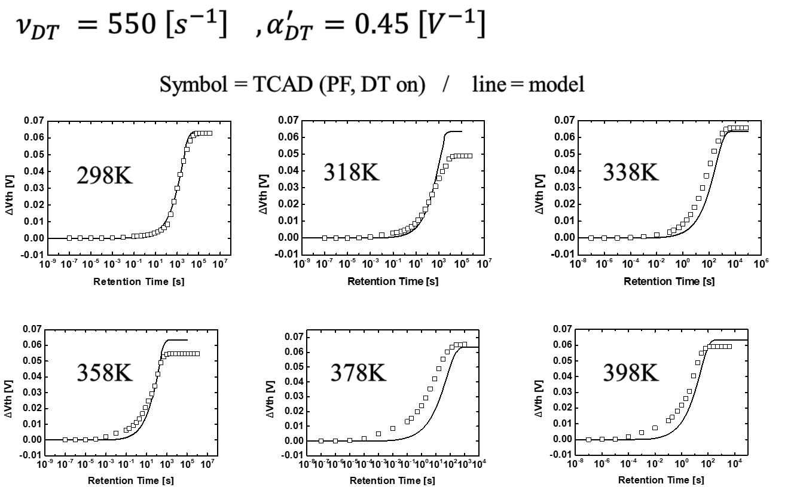
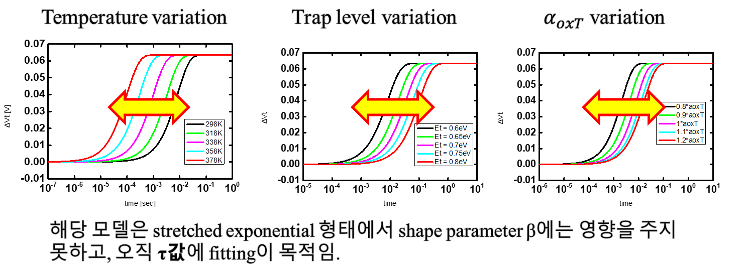
Remind) 24.4 Detrap TCAD Calibration
TCAD Calibration result from 24.4 >> ν_{DT} = 550 : consistent with the modeling
Fitting with α’_{DT}
is valid enough
5/8
School of Electrical Engineering, Seoul National University

Slide 6
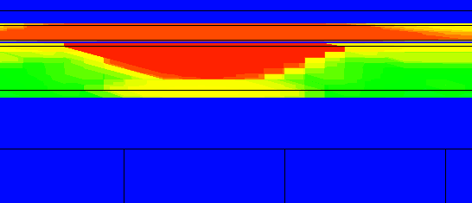
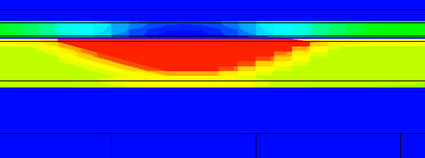
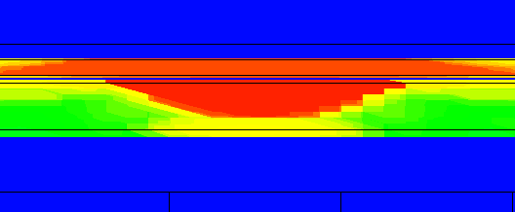
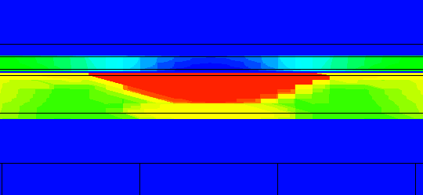
TCAD Detrap Simulation Method
eXsection, hXsection 1e-15~1e-16 => 1e-30 축소를 통한 ctn emission off
∵ ν_{PF} = N_{C}v_{th}σ_{c} => σ_{c}의 변수 직접 조정으로 ctn의 trapped electron lock
σ_{c,e} = 2x10⁻¹⁵ , σ_{c,h} = 1x10⁻¹⁵ [cm⁻²]
256s Retention
LM occured
σ_{c,e} = 2x10⁻³⁰ , σ_{c,h} = 1x10⁻³⁰ [cm⁻²]
256s Retention
256s Retention
No LM
6/8
School of Electrical Engineering, Seoul National University

Slide 7
TCAD Detrap Simulation Method
σ_{c,e} = 2x10⁻¹⁵ , σ_{c,h} = 1x10⁻¹⁵ [cm⁻²]
σ_{c,e} = 2x10⁻³⁰ , σ_{c,h} = 1x10⁻³⁰ [cm⁻²]
Capture Cross Section 조절을 통하여 CTN 영역의 전자의 움직임을 최소화 할 수 있음.
7/8
School of Electrical Engineering, Seoul National University

Slide 8
Future Works
TCAD Calibration
Device spec : DRL BE-TOX 가장 최신 spec 활용 예정
Trap profile : discrete level 활용 예정 (ex. 0.5eV, 0.6eV…)
3D Modified Poole-Frenkel Emission
α’ Calibration
8/8
School of Electrical Engineering, Seoul National University

